Slide 1

5G Wireless Technology
Presented By:-
JV’n Shweta Koushik
(JV-U/17/1211)
B.Tech (CSE) 3rd Year
JV’n Manvi Varshney
(JV-UL/17/1325)
B.Tech (CSE) 3rd Year

Slide 2

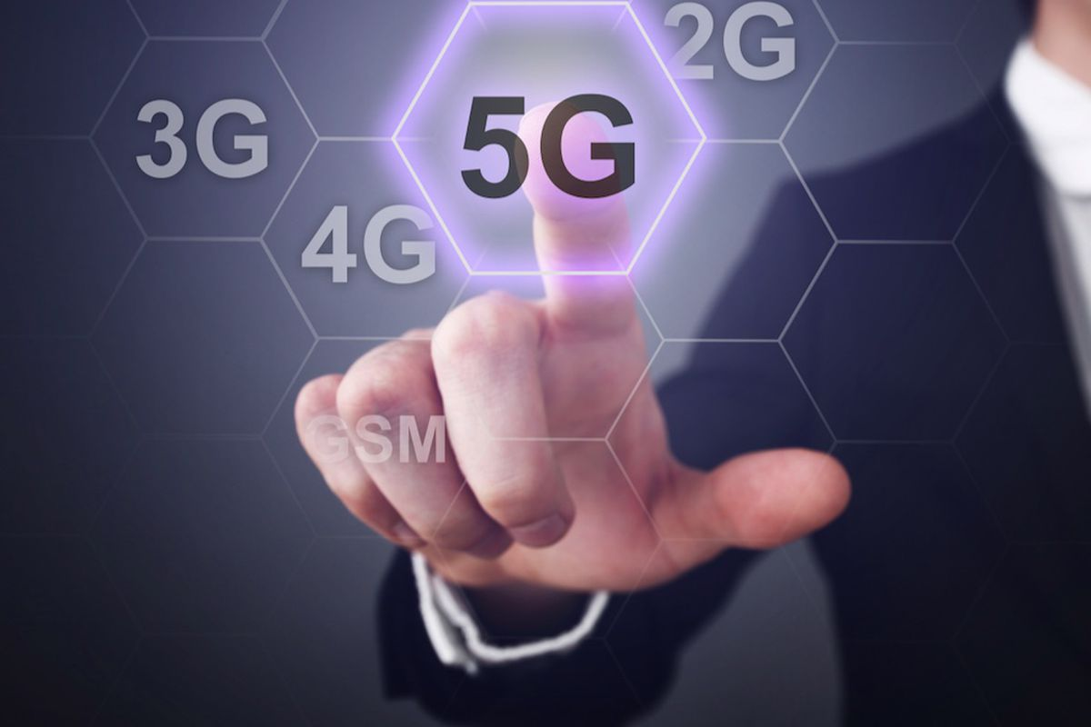

Contents
Introduction
Evolution of wireless technologies
Features
Conclusion

Slide 3


Introduction
Just like the previous generation of wireless cellular technology comes with the fifth generation, the 5G continues to improve, but also introduces a bunch of new technologies.

Slide 4


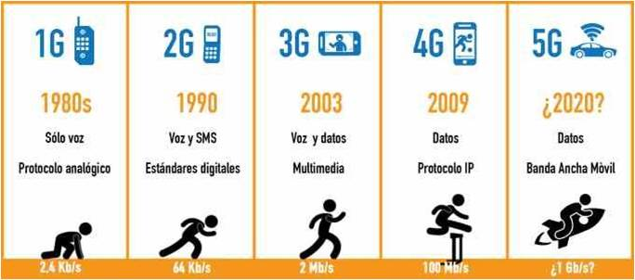
Technology Walk

Slide 5
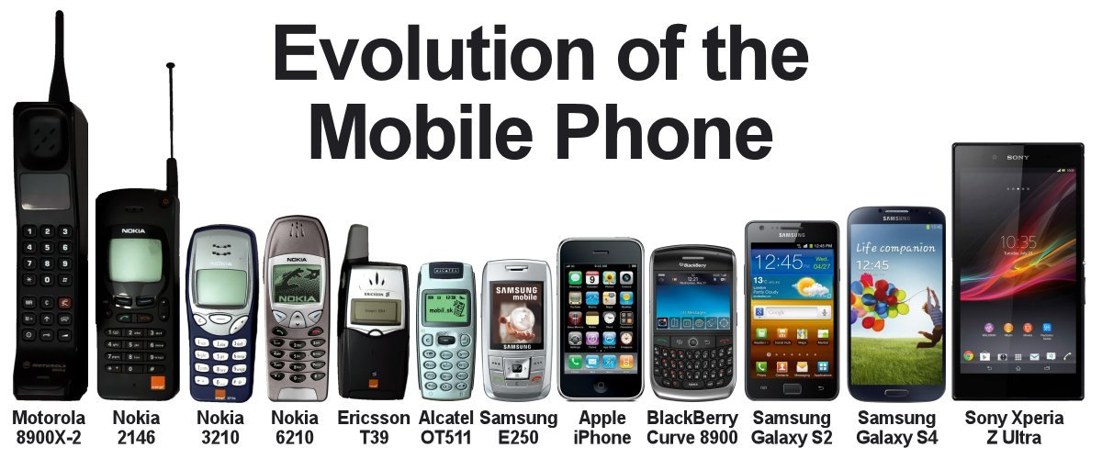
Evolution Of Generations

Slide 6
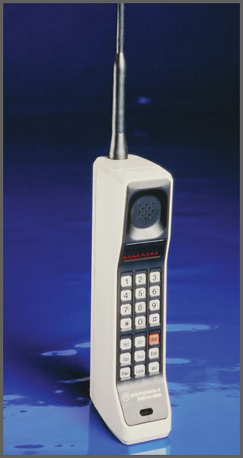

First Generation
The First Generation was launched in Japan by “Nippon Telegraph & Telephone.
It was introduced in 1980s.
The radio signals used by 1G networks are analog.

Slide 7
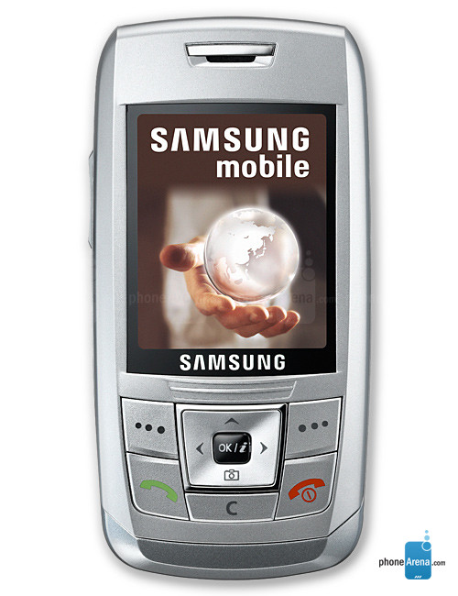

Second Generation
The Second Generation was launched on the GSM standard in Finland by Radiolinja in 1991.
2G introduced data services for mobile, starting with SMS text messages, Picture messages and MMS.

Slide 8

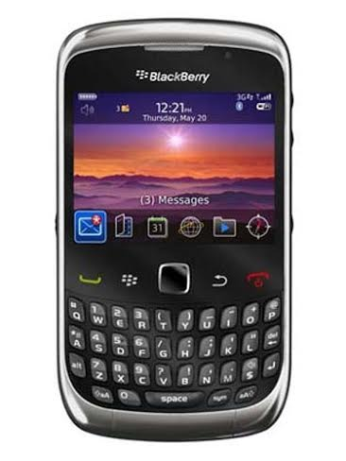

Third Generation
The Third Generation was launched by NTT DoCoMo in Japan.
3G finds applications in wireless voice telephony, Mobile Internet Access, Fixed wireless internet access, Video calls ,Mobile TV and Camera.

Slide 9
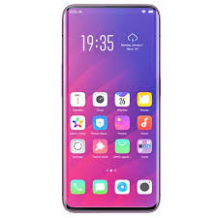



Fourth Generation
It was introduced in 2009.
4G introduced IP telephony, Gaming services, Video conferencing, 3D television and Online shopping.

Slide 10
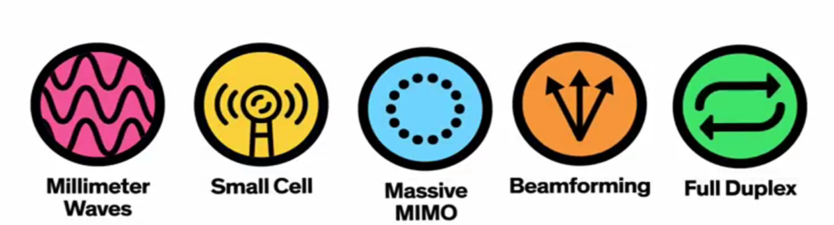
Features Of 5G
It can handle more traffic.
It can work 10 times more faster than 4G.
The theoritical speed of 5G connections is upto 20 Gbps/sec.
The 5 basic technologies used in 5G are:

Slide 11

Conclusion
5G technology is the upcoming technology and bandwidth is very high and high data transfer rate for it. Now we are using 4G technology efficiently but in future we can use the 5G technology.
The 5G technology will be available in the market at affordable rates, high peak future and much reliability than preceding technologies.

Slide 12


